Slide 1
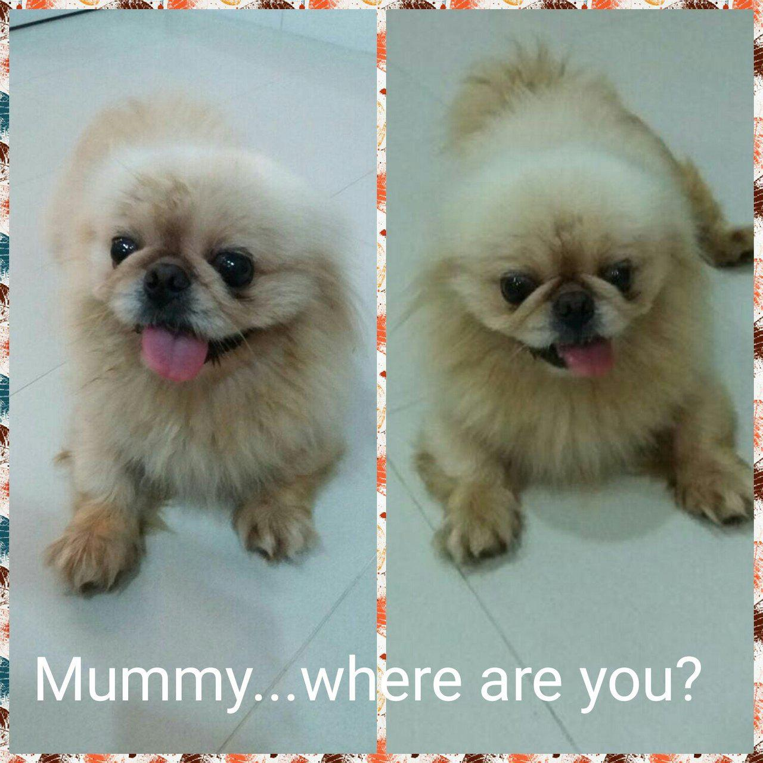
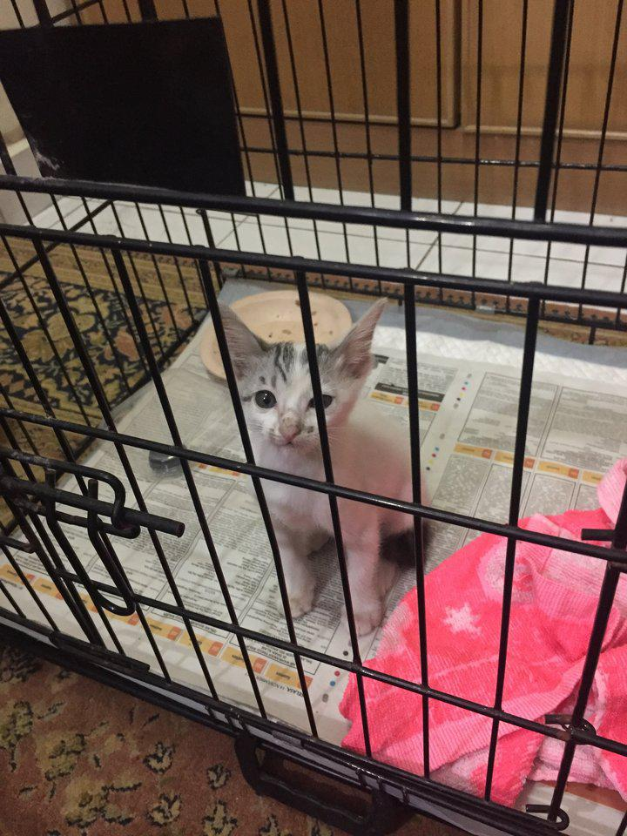
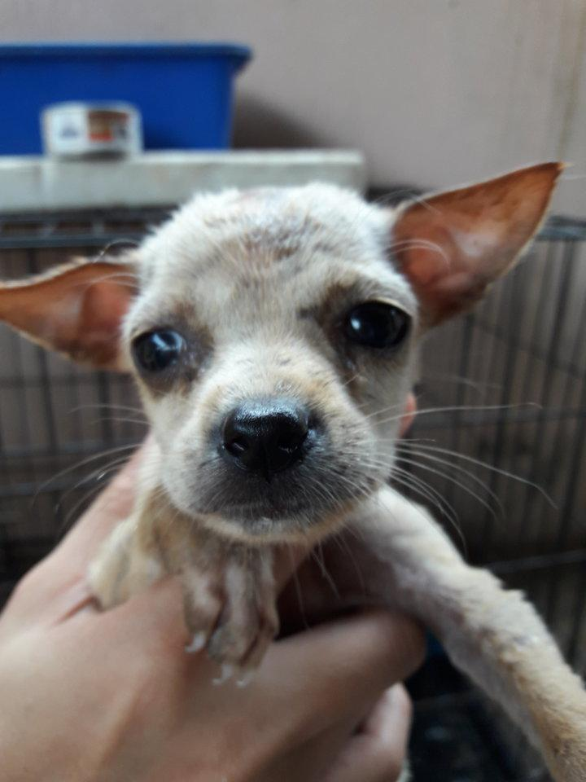
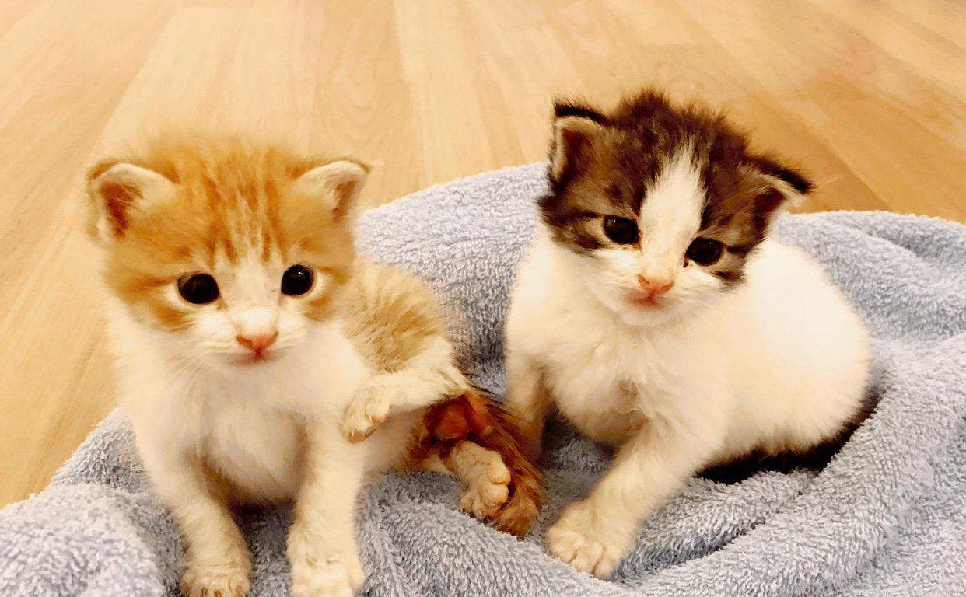
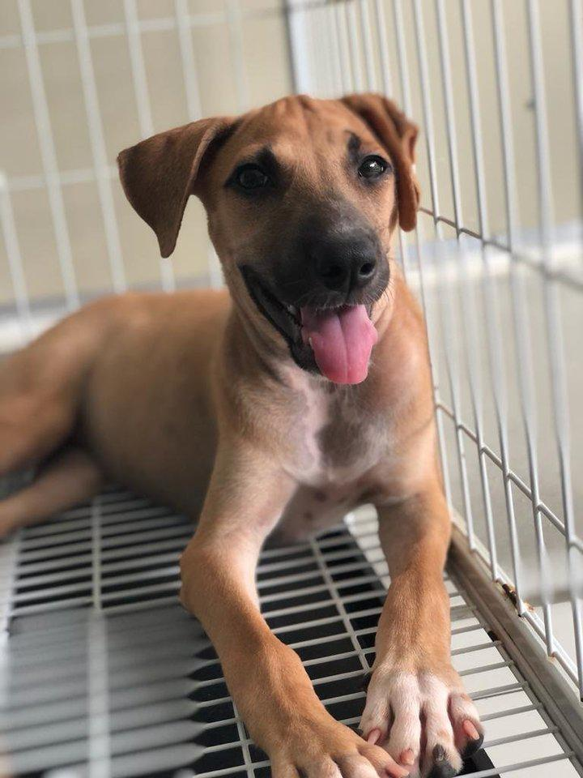
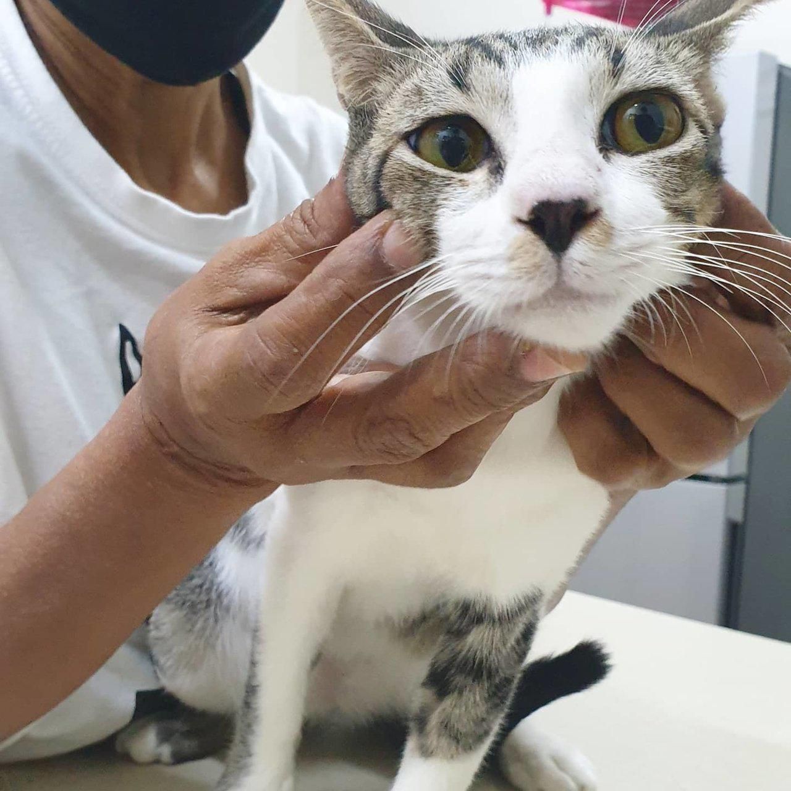
Predicting Pawpularity
Using Image Data, Computer Vision and Deep Learning to Support Pet Adoption

Slide 2
Contents
What is pawpularity and why is it important?
Data – what do we have to work with?
Methods – how to get the best prediction?
Results and Takeaways

Slide 3

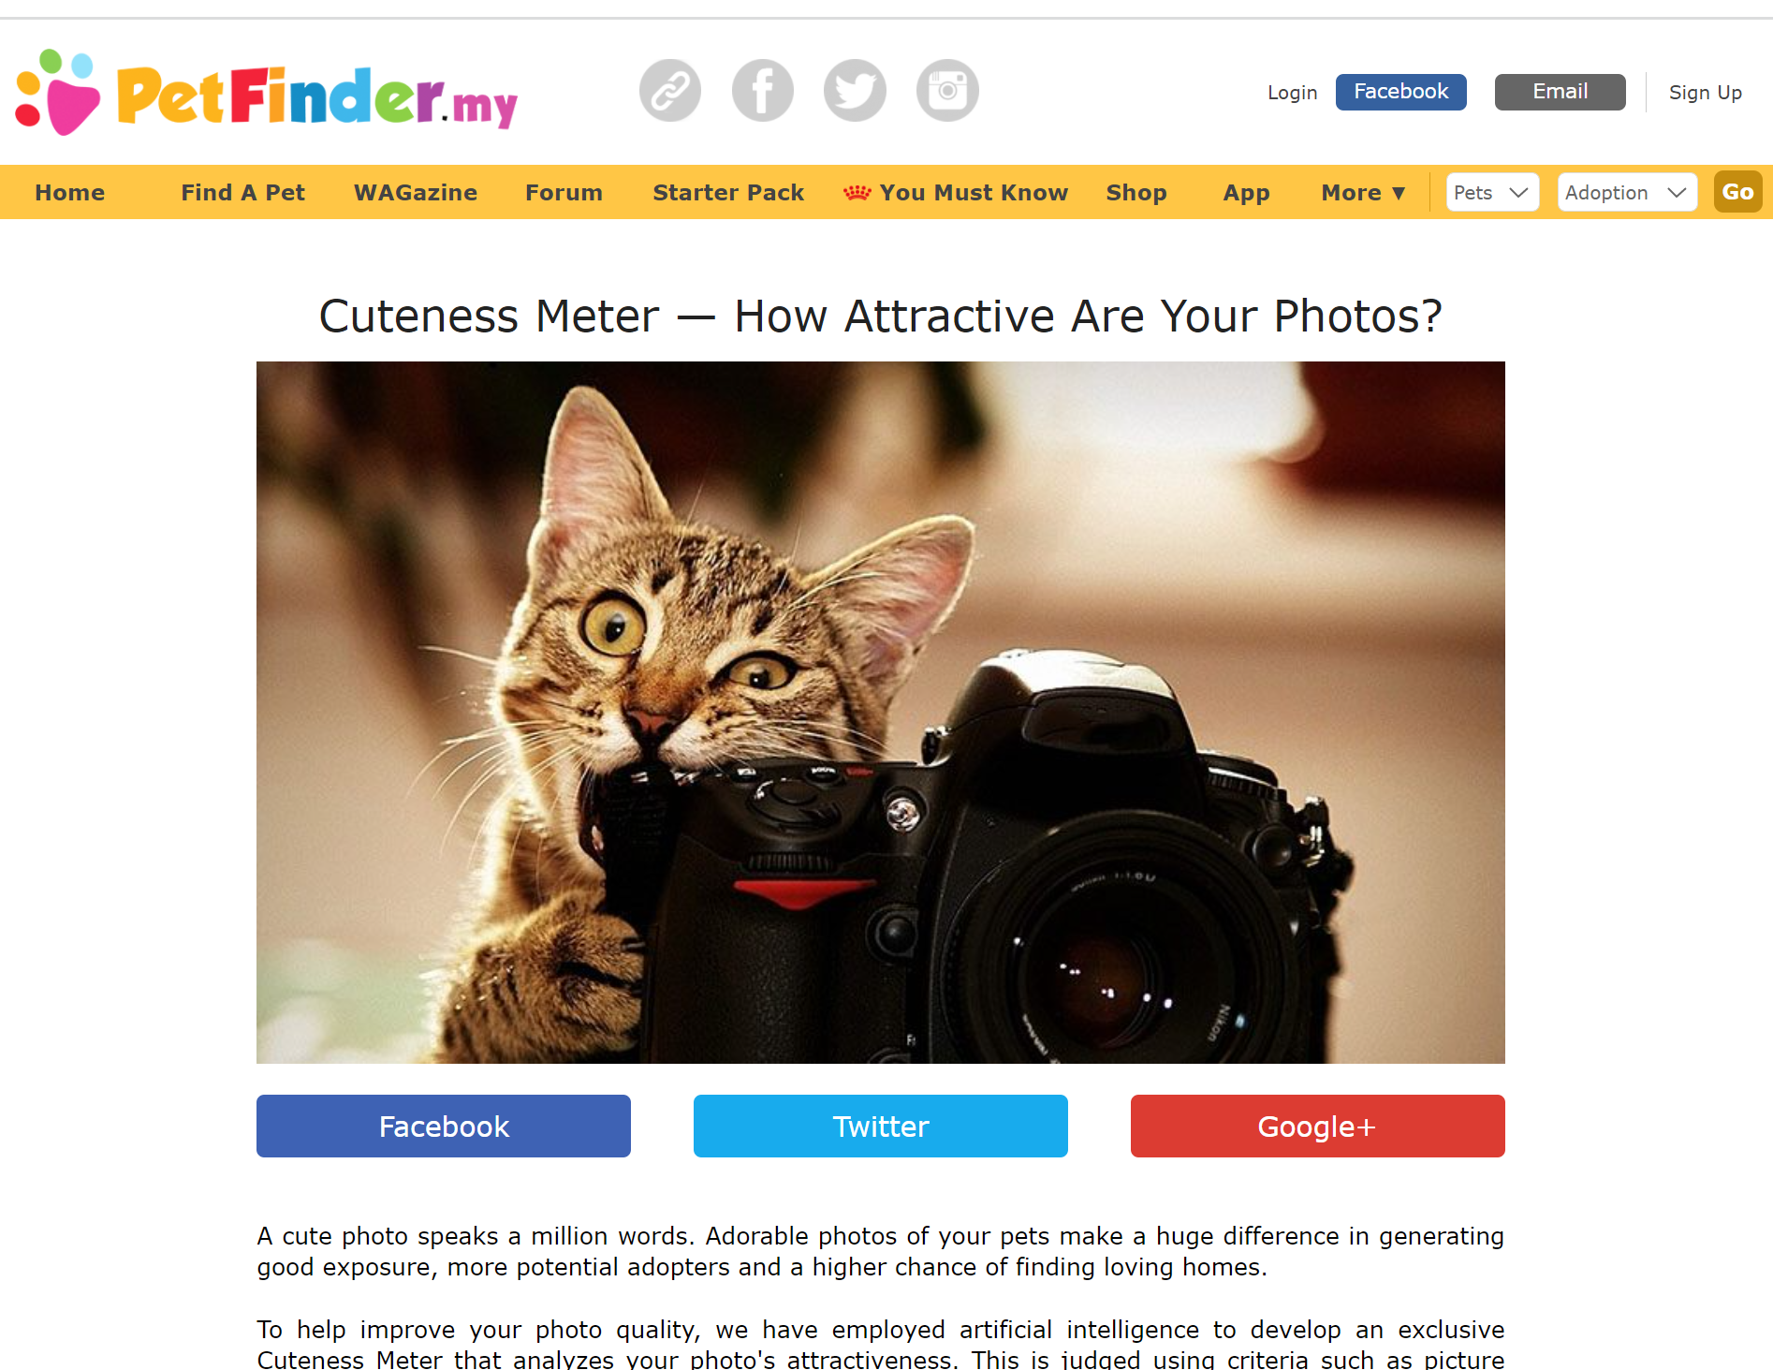
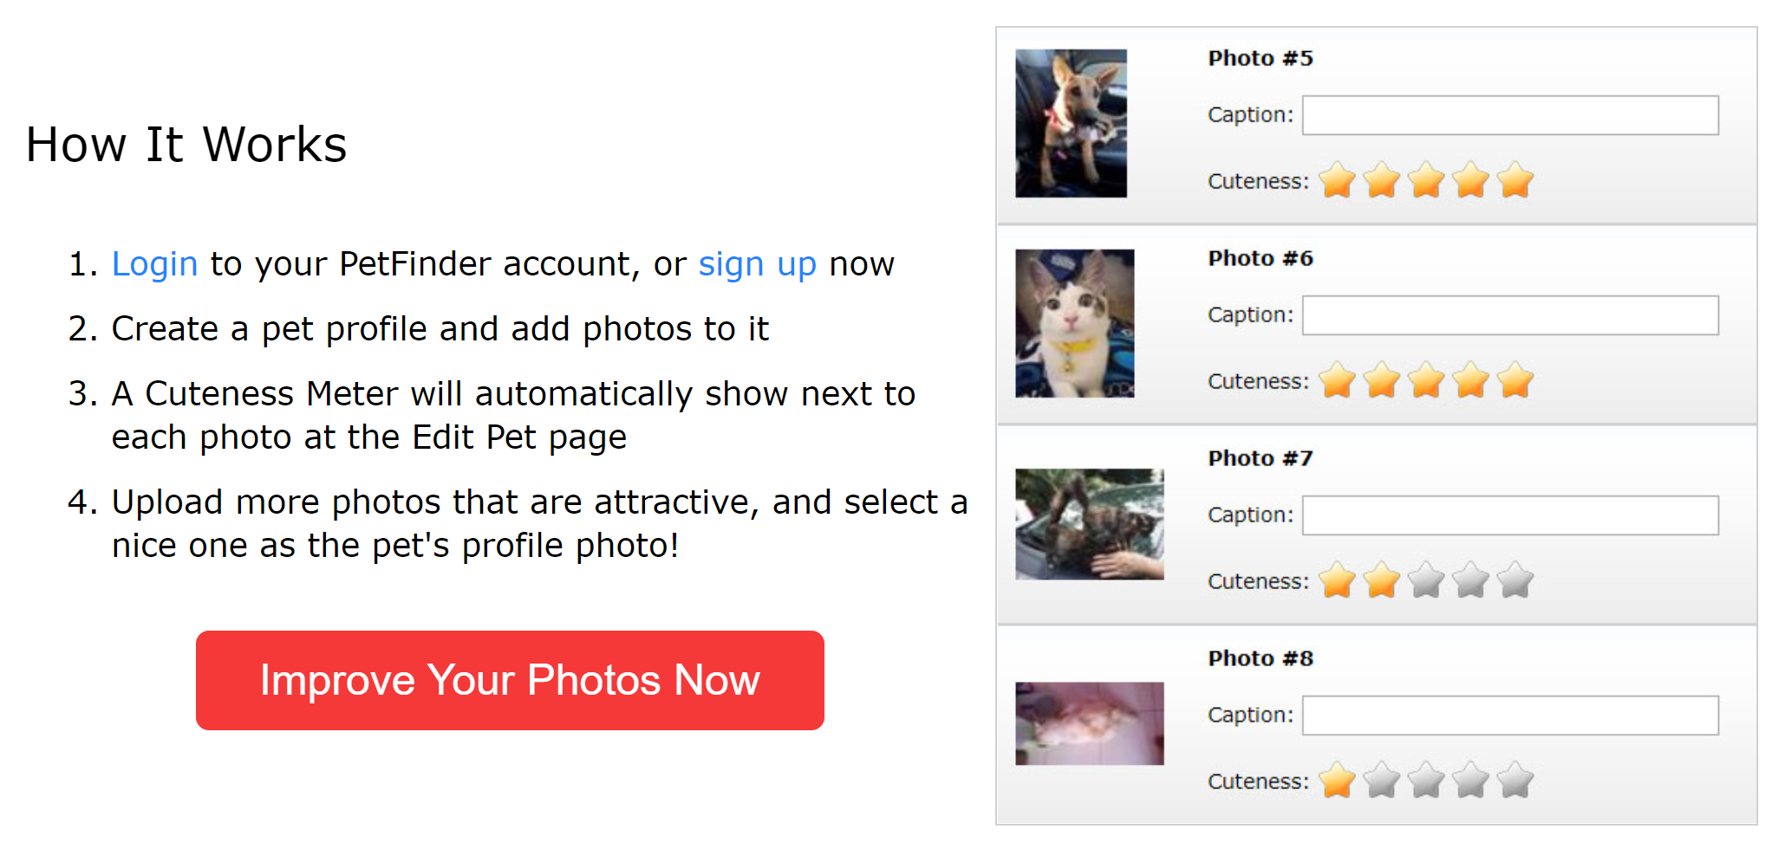

“PetFinder.my is Malaysia’s leading animal welfare platform, featuring over 180,000 animals with 54,000 happily adopted. PetFinder collaborates closely with animal lovers, media, corporations, and global organizations to improve animal welfare”
A pet’s pawpularity score (0 – 100) is based on internet traffic on pet’s profile

Slide 4
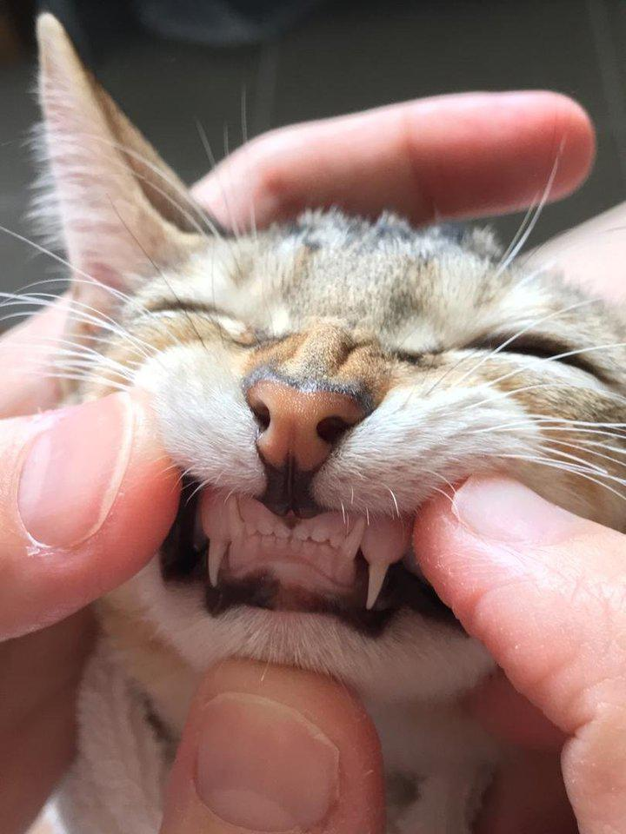
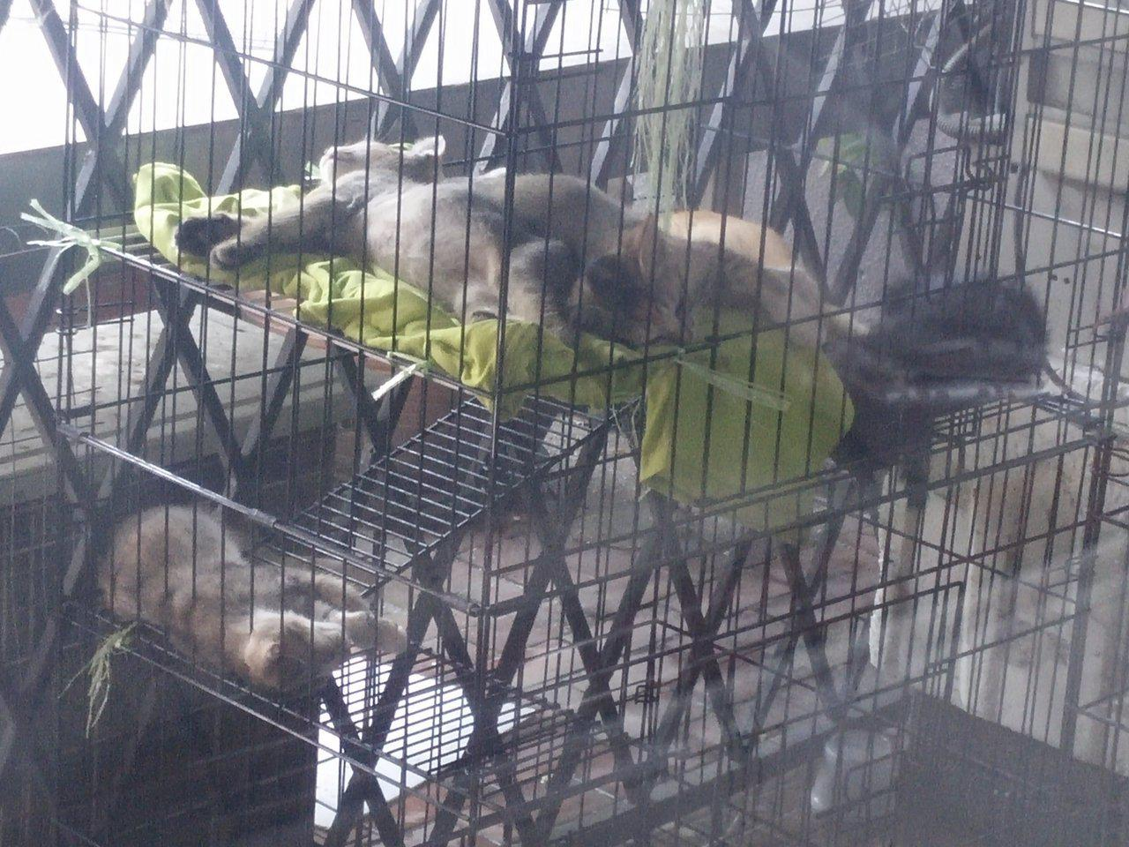
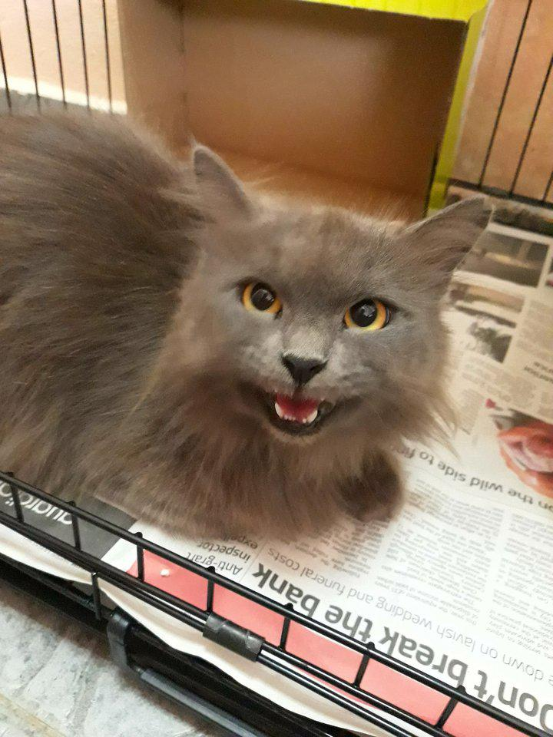
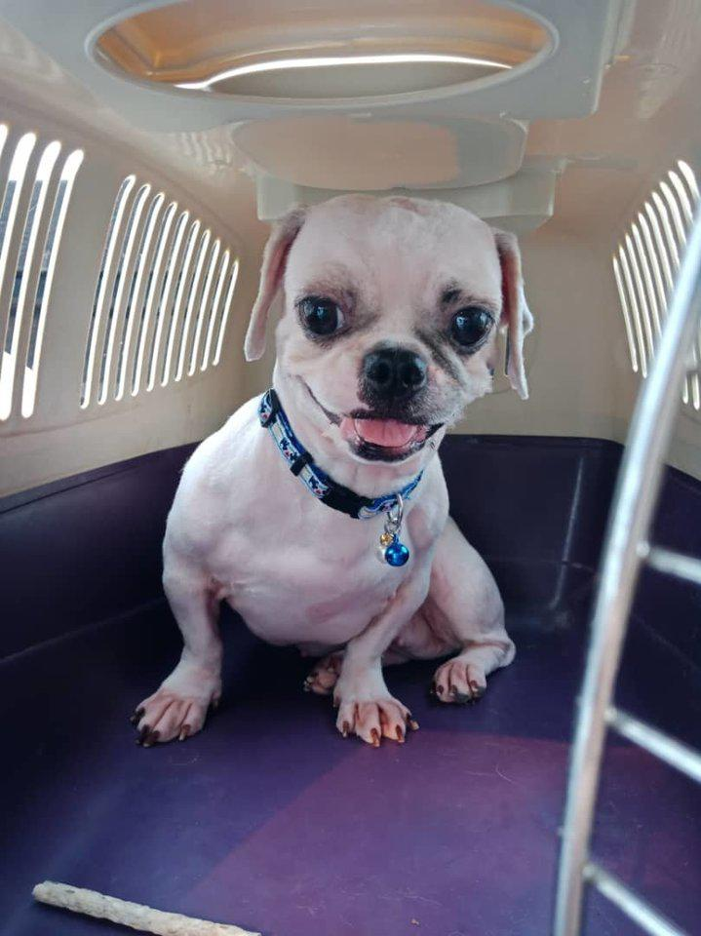
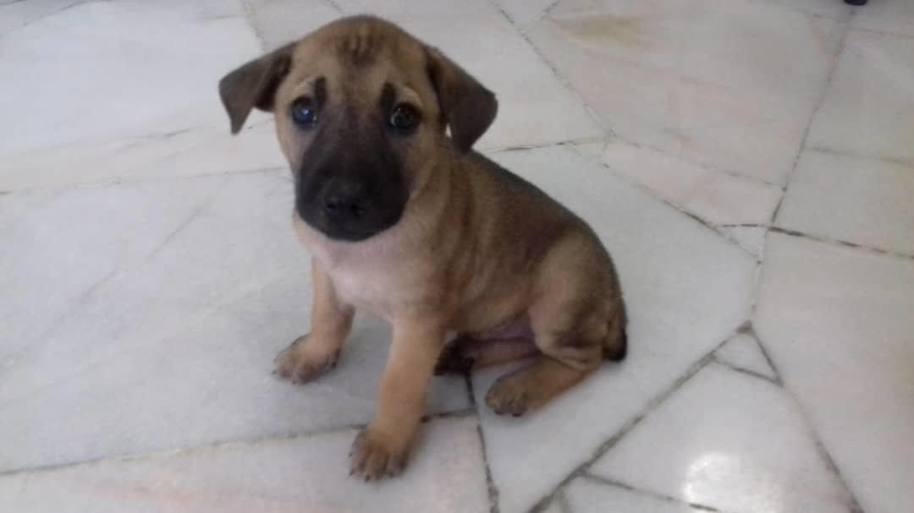
Data
Almost 10,000 images of dogs and cats in different qualities and sizes
For each image, 12 columns of metadata and the “Pawpularity” score (best score = 100)
Pawpularity Score = 37
Pawpularity Score = 82
Pawpularity Score = 31
Pawpularity Score = 24
Pawpularity Score = 100
(???)

Slide 5
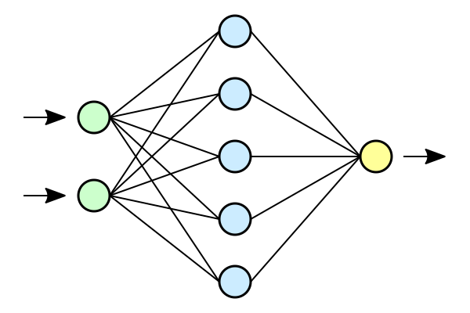
Chosen method: Convolutional Neural Network
Convolutional Neural Networks (CNNs, or ConvNets) are deep learning networks especially suited for analyzing image data.
CNNs are commonly used to classify images. To predict continuous data, a regression layer can be used at the end of the network.One

Slide 6
Utilised 4 different Models
Model 1: only metadata, with mutliple dense layers
Model 2: only image data, with 1 neuron layer
Model 3: only image data, with 2 neuron layers
Model 4: both metadata and image data, with multiple neuron layers

Slide 7
Performance of four different models (Mean Absolute Error)

Slide 8
Which one is the best model?
Only Metadata
CNN 1-layer
CNN 2-layer
Both MD
and CV
RMSE: 26.20
MAE: 18.73
RMSE: 20.43
MAE: 15.99
RMSE: 20.99
MAE: 16.93
RMSE: 21.67
MAE: 15.76

Slide 9
Key takeaways
Overfitting and processing times are the main problem – finding a balance is the challenge.
We can now estimate the Pawpularity score with an average divergence of 16 points
Computer Vision and Deep Learning can be used to not only classify but also score images – CV can see things that we don’t

Slide 10
Thanks for listening!
Sources
Information
https://www.mathworks.com/help/deeplearning/ug/train-a-convolutional-neural-network-for-regression.html
Images
Animal pictures from www.mypetfinder.my
Neural Network Image from https://commons.wikimedia.org/wiki/File:Neural_network.svg

Slide 11
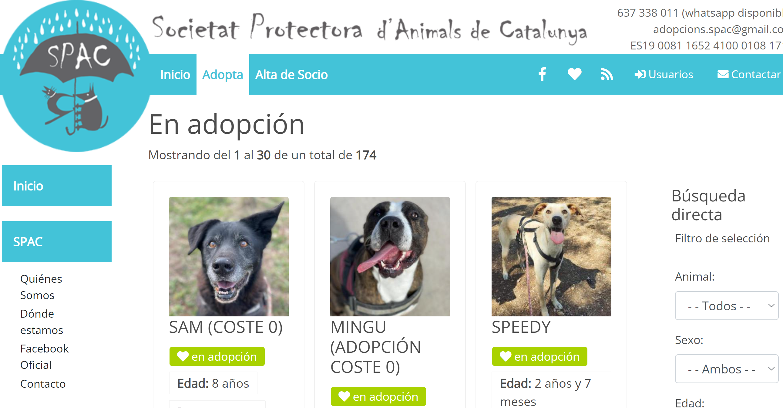
To adopt locally, go to https://spac.cat/

